Slide 1


Plant Disease Detection Capstone Project – DAB 422 St. Clair College Prepared by: Group 12 Under the guidance of Prof. Harpreet Virk

Slide 2

Introduction
Agriculture is a major sector supporting global food production.
Plant diseases significantly reduce crop yield and cause financial losses.
Traditional disease detection depends on manual inspection by experts.
This method is time-consuming and costly.
AI and Deep Learning can help automatically detect diseases from plant leaf images.

Slide 3
Methodology
Machine Learning Pipeline:
01
Data Collection
02
Data Preprocessing
03
Data Augmentation
04
Dataset Splitting
05
Model Development
06
Initial Training
07

Slide 4

Project Objectives
Primary Objectives
Analyze plant disease image dataset
Perform Exploratory Data Analysis (EDA)
Preprocess image data for deep learning
Build a CNN model for classification
Evaluate model accuracy
Secondary Objectives
Reduce overfitting using data augmentation
Experiment with transfer learning models
Build a prediction interface for users

Slide 5
Dataset Description
Dataset used: PlantVillage Dataset (Kaggle)
Dataset characteristics:
Image-based dataset which has thousands of plant leaf images
37 categories
Includes healthy and diseased leaves
RGB leaf images
Folder-based labeling system
Example classes:
Healthy leaves
Rust
Bacterial spot
Leaf blight

Slide 6
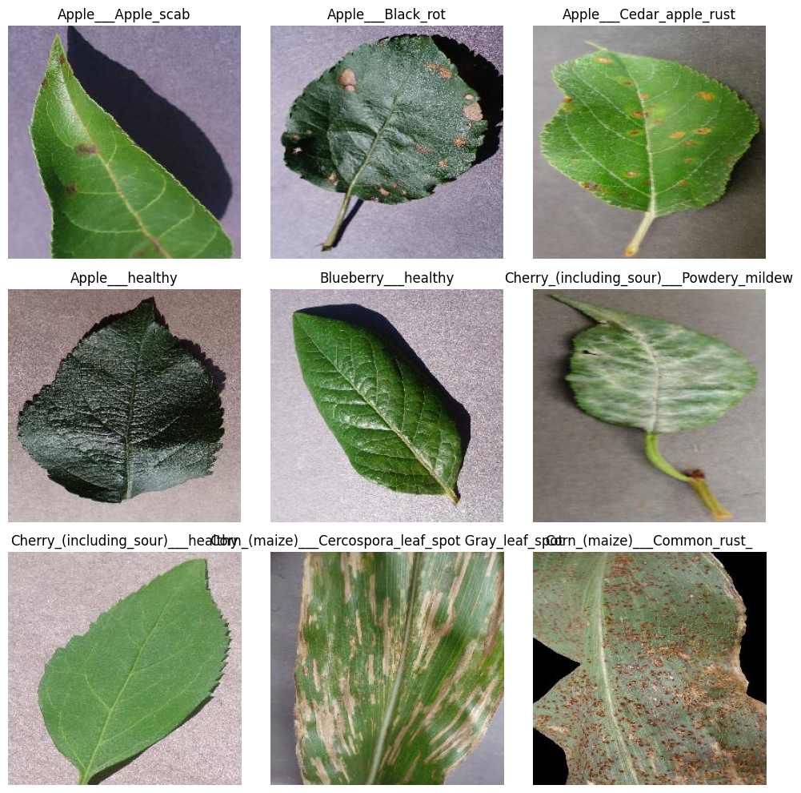

Exploratory Data Analysis (EDA)
Tools used:
Python
TensorFlow
Matplotlib
PIL
Visualize sample images
EDA steps performed:
Count total images in dataset
Identify number of classes

Slide 7
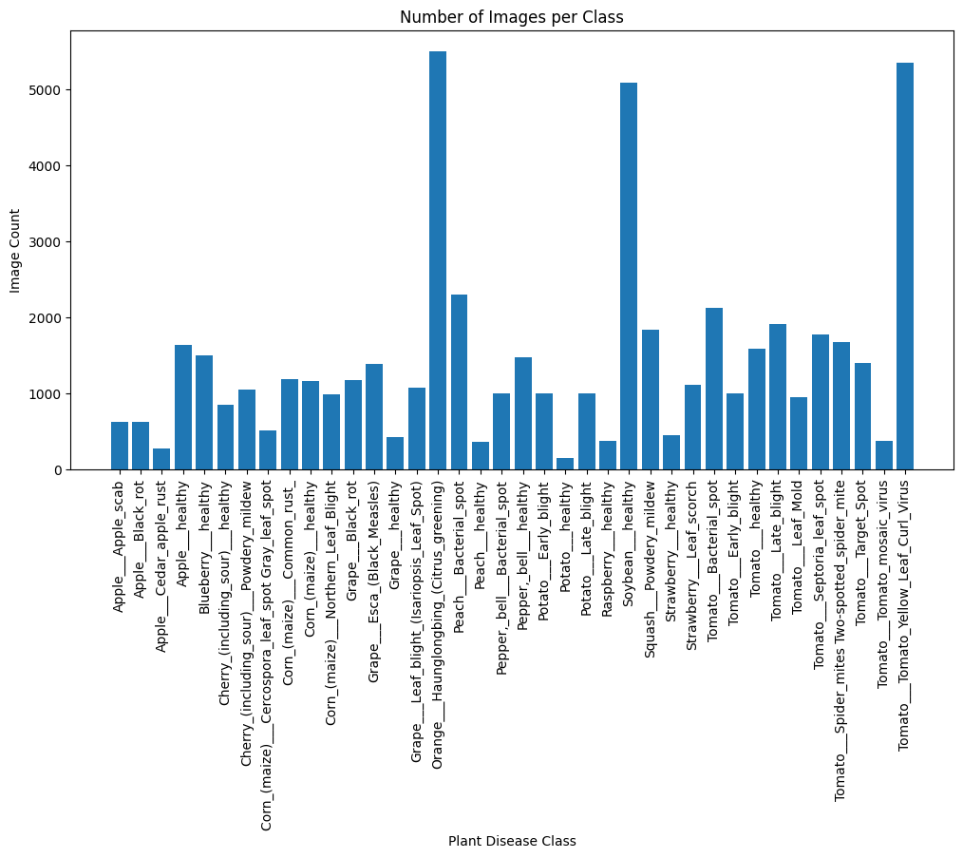
Analyze class distribution

Slide 8
Model Development
Model used: Convolutional Neural Network (CNN)
Layers used:
Convolutional layers
MaxPooling layers
Dense layers
Activation functions:
ReLU
Softmax
Initial results:
Training Accuracy: ~85%
Loss: ~15%
Observations:
CNN extracts disease patterns effectively
Accuracy improves with each epoch
Augmentation helps reduce overfitting
Training setup:
Epochs: 10
Image size: 256 × 256

Slide 9
Work Remaining
Future improvements:
Evaluation
Confusion Matrix
Precision, Recall, F1 Score
Deployment
Build web interface
Upload leaf image for prediction

Slide 10
Conclusion
Deep learning shows strong potential for plant disease detection.
Dataset analysis confirms suitability for CNN models.
Initial model results are promising.
Future work will focus on model optimization and deployment.

